Slide 1


Bristol Air Quality Exploration
Group36: Jinyi Liu, Xiyu Jin, Xingyu Liu, Chengrui Li

Slide 2
Data Source
Traffic
EV cars
Affect
Air Quality in Bristol
（from 2020-02-15 to 2022-02-24 ）
Industry
Mobility
Data source link below ： https://uob-my.sharepoint.com/:w:/r/personal/dz21013_bristol_ac_uk/_layouts/15/Doc.aspx?sourcedoc=%7B871a7fba-e5fb-4046-ab8b-ae5a4c39f2f7%7D&action=default

Slide 3
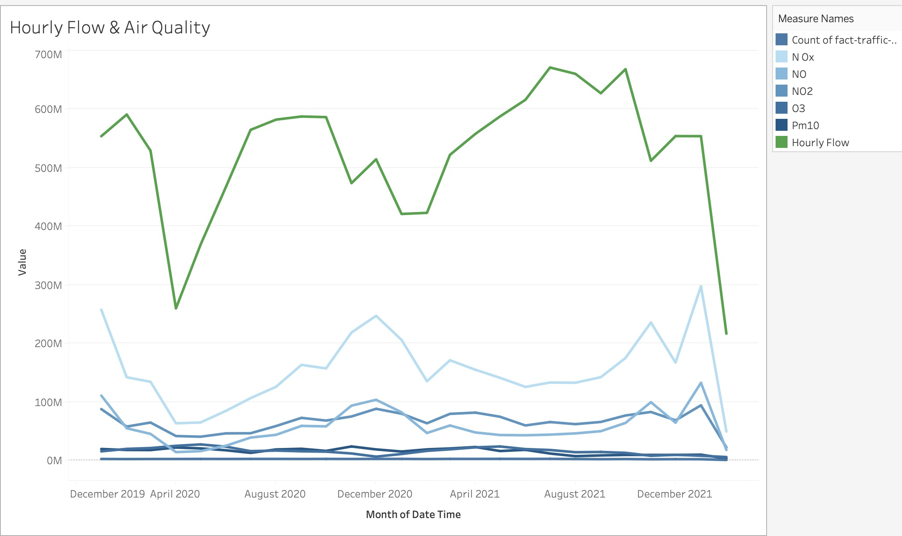
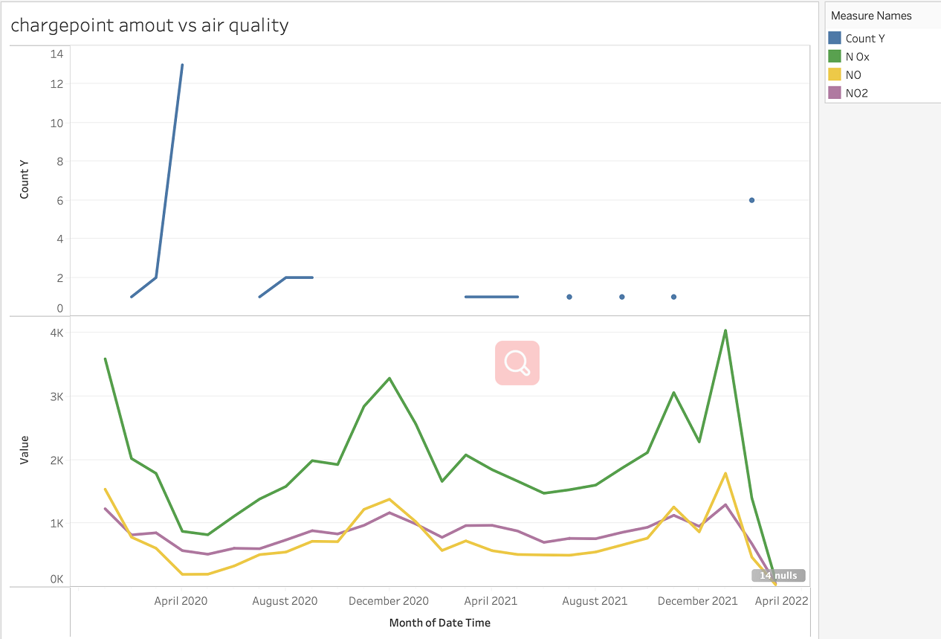
OUR PROGRESS
Hourly Flow & Air Quality
the amount of new-built chargepoints & Air Quality
Notes:
https://www.miskawaanhealth.com/wp-content/uploads/2021/04/air-pollution.jpg
https://www.flaticon.com

Slide 4
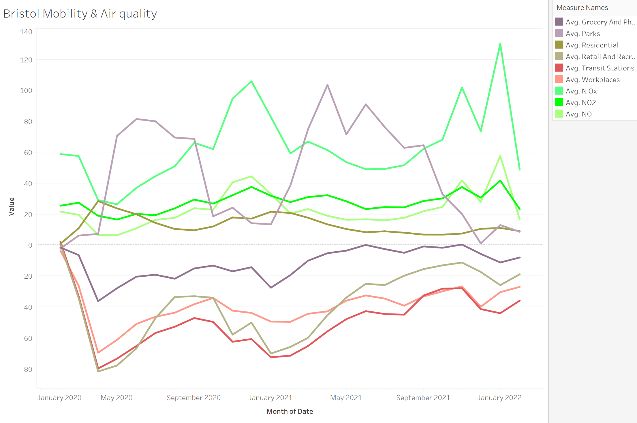
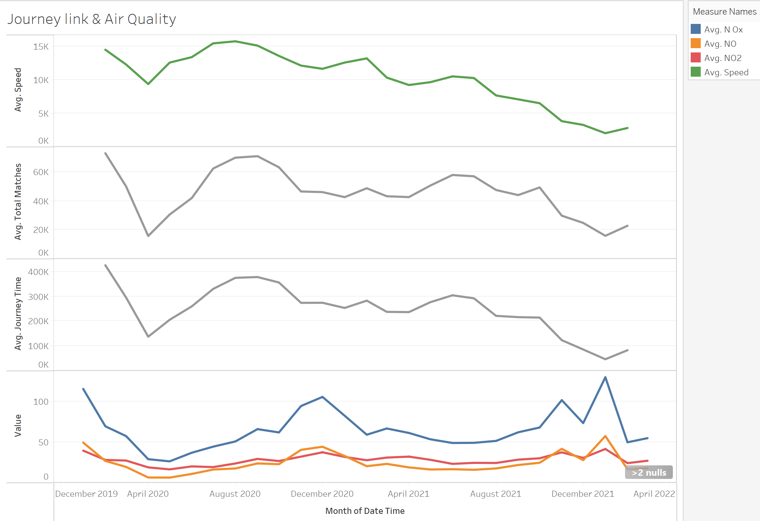
Bristol Mobility & Air Quality
Journey Link & Air Quality

Slide 5
Challenges
Next planned step
Replacement
Null values
Training different models
Finding an appropriate model
Metrics for measuring performance
Evaluation

